Slide 1
Active Shooter Presentation How to Lock/Secure Classroom Doors
Lecture: HIB 110; Discussion: HH 118;
Coding Project Clinic: SH 128
After discussion with OIT Classroom Technology Support, I have confirmed that there is no way to lock these doors manually
You must call the UCI Police Department and ask them to lock the doors remotely
EMERGENCY - CALL 911
NON-EMERGENCY - (949) 824-5223

Slide 2
Introduction to Artificial Intelligence
CS271P, Fall Quarter, 2018
Introduction to Artificial Intelligence
Prof. Richard Lathrop
Read Beforehand: R&N 1-2, 26.preamble, 26.3-4, 27.4
Optional: R&N 26.1-2, 27.1-3
Notes:
<number>

Slide 3
People
Instructor: Richard Lathrop, <rickl@uci.edu>
Office hours Tue/Thu, 4-5pm, DBH 4224
TA: Junkyu Lee <junkyul@uci.edu>
Office hours TBD
Reader: TBD
Coding Project/Tournament: Clinic Wed, 2-2:50pm, SH 128
Director: Jian Li <jianl9@uci.edu>
Assistant Director: Jia Yao <jiahy@uci.edu>

Slide 4
Course outline
https://canvas.eee.uci.edu/courses/TBD
Framed around three pillars of AI
Search
Logic
Learning (see also CS178)
Project:
TBD agent & tournament
Tournament Director: TBD
Weekly Project Clinic, TBD

Slide 5
Course outline
Collaboration OK
Grading
Optional Homeworks (5), not graded
Discussion participation (10%; 7 of 10)
Quizzes (20%)
Four in-class quizzes: 10/12, 10/26, 11/21, 12/5
Project (20%)
Wumpus World
Teams of 1 or 2
Several milestones through quarter; teams due 10/8
Midterm (25%)
In class, 11/7
Final (25%)
Cumulative
12/15, 10:30-12:30 (note different time!)

Slide 6
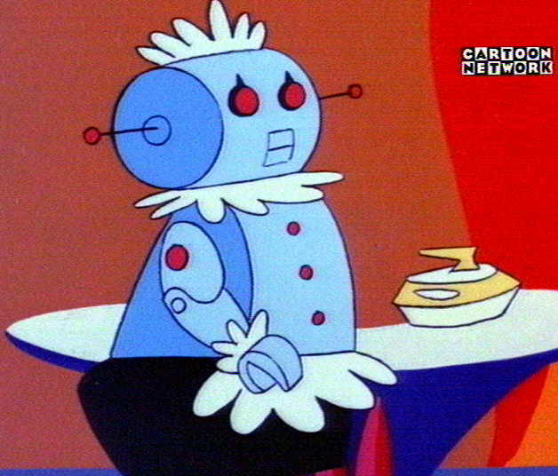
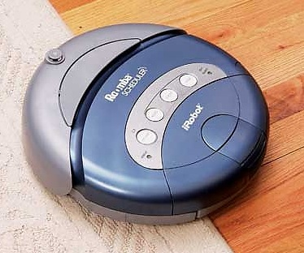
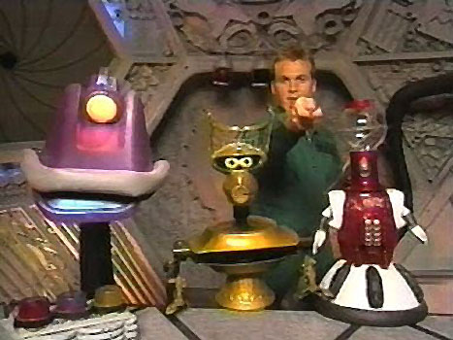
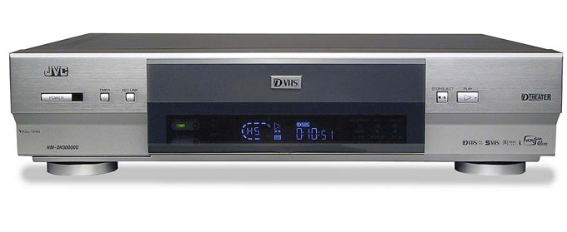
What is AI?
?
=
?
=

Slide 7
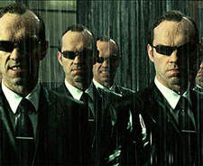
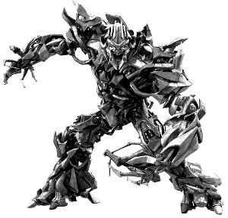
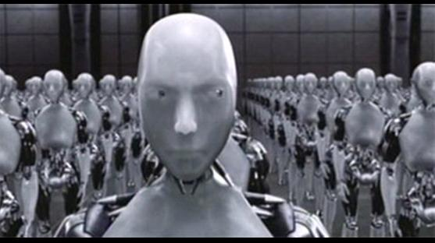
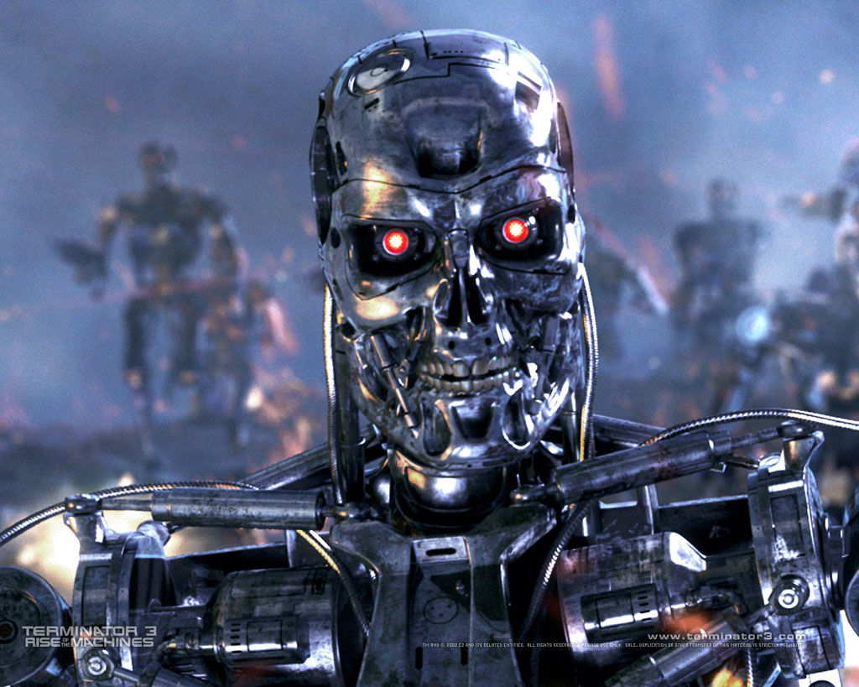

What is AI?

Slide 8
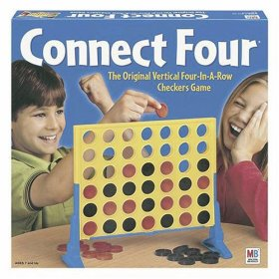
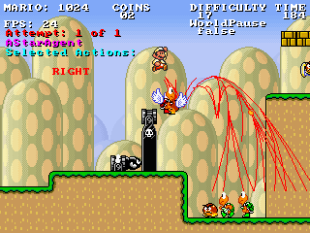
AI and Games
AI as an opponent
Responsive & “realistic” behavior
AI as an assistant
Simplify interface, “do what you want”

Slide 9
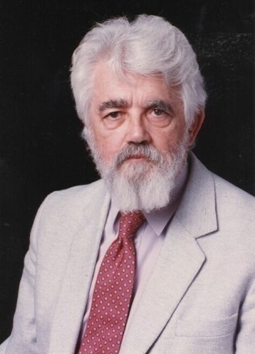
What is Artificial Intelligence (John McCarthy , Basic Questions)
What is artificial intelligence?
It is the science and engineering of making intelligent machines, especially intelligent computer programs. It is related to the similar task of using computers to understand human intelligence, but AI does not have to confine itself to methods that are biologically observable.
Yes, but what is intelligence?
Intelligence is the computational part of the ability to achieve goals in the world. Varying kinds and degrees of intelligence occur in people, many animals and some machines.
Isn't there a solid definition of intelligence that doesn't depend on relating it to human intelligence?
Not yet. The problem is that we cannot yet characterize in general what kinds of computational procedures we want to call intelligent. We understand some of the mechanisms of intelligence and not others.
More in: http://www-formal.stanford.edu/jmc/whatisai/node1.html
Notes:
<number>

Slide 10

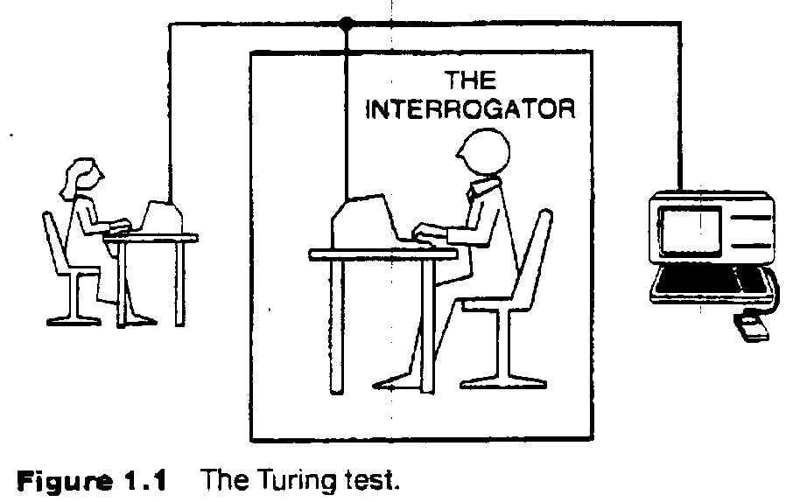
The Turing test
Can Machine think? A. M. Turing, 1950
Test requires computer to “pass itself off” as human
Necessary?
Sufficient?
Requires:
Natural language
Knowledge representation
Automated reasoning
Machine learning
(vision, robotics) for full test

Slide 11
What is Artificial Intelligence?
Nils J. Nilsson :
“Artificial intelligence is that activity devoted to making machines intelligent, and intelligence is that quality that enables an entity to function appropriately and with foresight in its environment.”

Slide 12
What is Artificial Intelligence?
Thought processes
“The exciting new effort to make computers think .. Machines with minds, in the full and literal sense” (Haugeland, 1985)
Behavior
“The study of how to make computers do things at which, at the moment, people are better.” (Rich, and Knight, 1991)
Activities
The automation of activities that we associate with human thinking, activities such as decision-making, problem solving, learning… (Bellman)
Things we would call “intelligent” if done by a human
Notes:
<number>

Slide 13


AI as “Raisin Bread”
Esther Dyson [predicted] AI would [be] embedded in main-stream, strategically important systems, like raisins in a loaf of raisin bread.
The “bread” represents any main-stream computer-augmented engineering system.
The “raisins” represent nuggets of control, where “smart” control ⇒ better function.
Time has proven Dyson's prediction correct.
Emphasis shifts away from replacing expensive human experts toward main-stream computing systems that create strategic advantage.
Many AI systems connect to large data bases, deal with legacy data, talk to networks, handle noise and data corruption, are implemented in popular languages, and run on standard operating systems.
Humans usually are important contributors to the total solution.
Adapted from Patrick Winston, former Director, MIT AI Laboratory

Slide 14
What is AI?
Competing axes of definitions:
Thinking vs. Acting
Human-like vs. Rational
Often not the same thing
Cognitive science, economics, …
How to simulate human intellect & behavior by machine
Mathematical problems (puzzles, games, theorems)
Common-sense reasoning
Expert knowledge (law, medicine)
Social behavior
Web & online intelligence
Planning, e.g. operations research

Slide 15
Act/Think Humanly/Rationally
Act Humanly
Turing test
Think Humanly
Introspection; Cognitive science
Think rationally
Logic; representing & reasoning over problems
Acting rationally
Agents; sensing & acting; feedback systems

Slide 16
Current “Hot” areas/applications
Big Data/knowledge extraction with Machine Learning
BD2K = “Big Data to Knowledge”
Deep Learning/artificial neural systems
Transportation/logistics/self-driving cars
Robotics/factory automation/mobility for the disabled
Vision/scene or video analysis
Internet/social media
Biology/medicine/improving healthcare
Question answering/knowledge retrieval
Finance/market trading/personal wealth management
Your favorite area here….

Slide 17

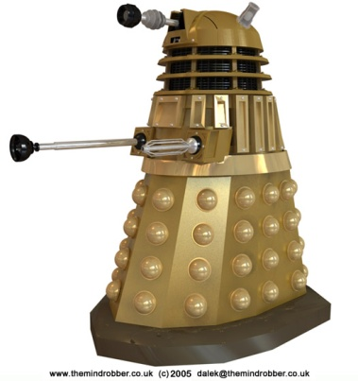
Agents
An agent is anything that can be viewed as perceiving its environment through sensors and acting upon that environment through actuators
Human agent:
Sensors: eyes, ears, …
Actuators: hands, legs, mouth…
Robotic agent
Sensors: cameras, range finders, …

Slide 18
Agents
Craik (1943; R&N p. 13) specified the three key steps of a knowledge-based agent:
(1) the stimulus must be translated into an internal representation;
(2) the representation is manipulated by cognitive processes to derive new internal representations;
and (3) these representations are in turn retranslated back into action.

Slide 19
Agents
Craik (1943; R&N p. 13) explained why this is a good design for an agent:
“If the organism carries a ‘small-scale model’ of external reality and of its own possible actions within its head, it is able to try out various alternatives, conclude which is the best of them, react to future situations before they arise, utilize the knowledge of past events in dealing with the present and future, and in every way to react in a much fuller, safer, and more competent manner to the emergencies which face it.”

Slide 20
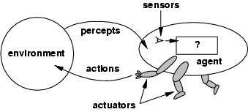
Agents and environments
Compare: Standard Embedded System Structure
sensors
ADC
microcontroller
DAC
actuators
ASIC
FPGA

Slide 21
Agents and environments
The agent function maps from percept histories to actions:
[f: P* → A]
The agent program runs on the physical architecture to produce f
agent = architecture + program

Slide 22
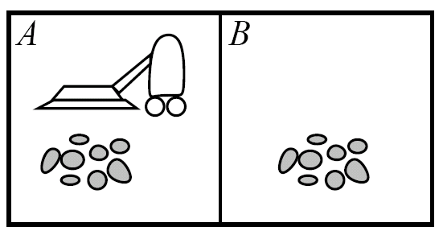
Vacuum World
Percepts: location, contents
e.g., [A, dirty]
Actions: {left, right, vacuum,…}

Slide 23
Rational agents
Rational Agent: For each possible percept sequence, a rational agent should select an action that is expected to maximize its performance measure, based on the evidence provided by the percept sequence and whatever built-in knowledge the agent has.
Performance measure: An objective criterion for success of an agent's behavior (“cost”, “reward”, “utility”)
E.g., performance measure of a vacuum-cleaner agent could be amount of dirt cleaned up, amount of time taken, amount of electricity consumed, amount of noise generated, etc.

Slide 24
Rational agents
Rationality is distinct from omniscience (all-knowing with infinite knowledge)
Agents can perform actions in order to modify future percepts so as to obtain useful information (information gathering, exploration)
An agent is autonomous if its behavior is determined by its own percepts & experience (with ability to learn and adapt) without depending solely on build-in knowledge

Slide 25
Discussion Items
An realistic agent has finite amount of computation and memory available. Suppose an agent is killed because it did not have enough computation resources to calculate some rare event that eventually ended up killing it. Can this agent still be rational?
The Turing test was contested by Searle by using the “Chinese Room” argument. The Chinese Room agent needs an exponential large memory to work. Can we “save” the Turing test from the Chinese Room argument?
Is “being intelligent” different from “having a mind?” Can a machine have a mind? consciousness?
If a machine does something that we would call “intelligent” if we saw a human do it, is the machine intelligent?

Slide 26
Task environment
To design a rational agent, we must specify the task environment ⎯ “PEAS”
Example: automated taxi system
Performance measure
Safety, destination, profits, legality, comfort, …
Environment
City streets, freeways; traffic, pedestrians, weather, …
Actuators
Steering, brakes, accelerator, horn, …
Sensors

Slide 27
PEAS
Example: Agent = Medical diagnosis system
Performance measure: Healthy patient, minimize costs, lawsuits
Environment: Patient, hospital, staff
Actuators: Screen display (questions, tests, diagnoses, treatments, referrals)
Sensors: Keyboard (entry of symptoms, findings, patient's answers)

Slide 28
PEAS
Example: Agent = Part-picking robot (a robot that picks up parts or tools and places them in a new location)
Performance measure: Percentage of parts in correct bins
Environment: Conveyor belt with parts, bins
Actuators: Jointed arm and hand
Sensors: Camera, joint angle sensors

Slide 29
Environment types
Fully observable (vs. partially observable): An agent's sensors give it access to the complete state of the environment at each point in time.
Deterministic (vs. stochastic): The next state of the environment is completely determined by the current state and the action executed by the agent. (If the environment is deterministic except for the actions of other agents, then the environment is strategic)
Episodic (vs. sequential): An agent’s action is divided into atomic episodes. Decisions do not depend on previous decisions/actions.
Known (vs. unknown): An environment is considered to be "known" if the agent understands the laws that govern the environment's behavior.

Slide 30
Environment types
Static (vs. dynamic): The environment is unchanged while an agent is deliberating. (The environment is semidynamic if the environment itself does not change with the passage of time but the agent's performance score does)
Discrete (vs. continuous): A limited number of distinct, clearly defined percepts and actions.
How do we represent or abstract or model the world?
Single agent (vs. multi-agent): An agent operating by itself in an environment. Does the other agent interfere with my performance measure?

Slide 31
task environm. | observable | determ./ stochastic | episodic/ sequential | static/ dynamic | discrete/ continuous | agents
crossword puzzle | fully | determ. | sequential | static | discrete | single
chess with clock | fully | strategic | sequential | semi | discrete | multi
poker
back gammon
taxi driving | partial | stochastic | sequential | dynamic | continuous | multi
medical diagnosis | partial | stochastic | sequential | dynamic | continuous | single
image analysis | fully | determ. | episodic | semi | continuous | single
partpicking robot | partial | stochastic | episodic | dynamic | continuous | single
refinery controller | partial | stochastic | sequential | dynamic | continuous | single
interact. Eng. tutor | partial | stochastic | sequential | dynamic | discrete | multi

Slide 32
task environm. | observable | determ./ stochastic | episodic/ sequential | static/ dynamic | discrete/ continuous | agents
crossword puzzle | fully | determ. | sequential | static | discrete | single
chess with clock | fully | strategic | sequential | semi | discrete | multi
poker | partial | stochastic | sequential | static | discrete | multi
back gammon
taxi driving | partial | stochastic | sequential | dynamic | continuous | multi
medical diagnosis | partial | stochastic | sequential | dynamic | continuous | single
image analysis | fully | determ. | episodic | semi | continuous | single
partpicking robot | partial | stochastic | episodic | dynamic | continuous | single
refinery controller | partial | stochastic | sequential | dynamic | continuous | single
interact. Eng. tutor | partial | stochastic | sequential | dynamic | discrete | multi

Slide 33
task environm. | observable | determ./ stochastic | episodic/ sequential | static/ dynamic | discrete/ continuous | agents
crossword puzzle | fully | determ. | sequential | static | discrete | single
chess with clock | fully | strategic | sequential | semi | discrete | multi
poker | partial | stochastic | sequential | static | discrete | multi
back gammon | fully | stochastic | sequential | static | discrete | multi
taxi driving | partial | stochastic | sequential | dynamic | continuous | multi
medical diagnosis | partial | stochastic | sequential | dynamic | continuous | single
image analysis | fully | determ. | episodic | semi | continuous | single
partpicking robot | partial | stochastic | episodic | dynamic | continuous | single
refinery controller | partial | stochastic | sequential | dynamic | continuous | single
interact. Eng. tutor | partial | stochastic | sequential | dynamic | discrete | multi

Slide 34
Agent types
Six basic types, in order of increasing generality:
Table Driven agents
Simple reflex agents
Model-based reflex agents
Goal-based agents
Utility-based agents
Learning agents

Slide 35
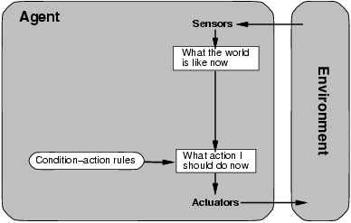
Table Driven Agent.
current state of decision process
Impractical
table lookup
for entire history

Slide 36
Simple reflex agents
Fast but too simple
NO MEMORY
Fails if environment
is partially observable
example: vacuum cleaner world

Slide 37
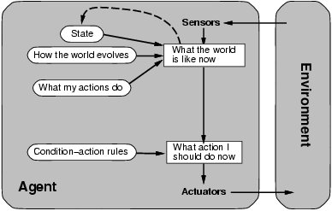
Model-based reflex agents
description of
current world state
Model the state of the world by:
modeling how the world changes
how its actions change the world
This can work even with partial information
It’s is unclear what to do
without a clear goal

Slide 38
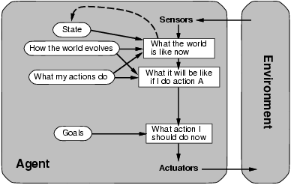
Goal-based agents
Goals provide reason to prefer one action over the other.
We need to predict the future: we need to plan & search

Slide 39
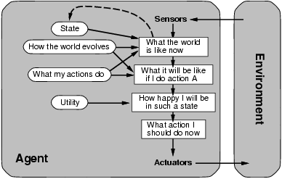
Utility-based agents
Some solutions to goal states are better than others.
Which one is best is given by a utility function.
Which combination of goals is preferred?

Slide 40
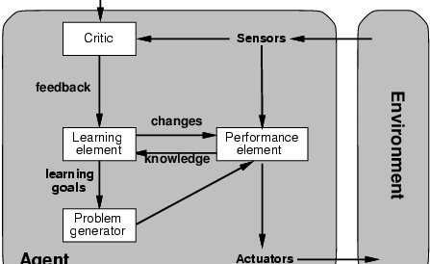
Learning agents
How does an agent improve over time?
By monitoring it’s performance and suggesting
better modeling, new action rules, etc.
Evaluates
current
world
state
changes
action
rules
“old agent”=
model world
and decide on
actions
to be taken
suggests
explorations

Slide 41
AI Foundations and Philosophy Weak AI vs. Strong AI Hypotheses
Weak AI hypothesis:
Machines could act as if they were intelligent
Strong AI hypothesis:
Machines that do so are actually thinking (not just simulating thinking)
My personal view: This question is really about linguistics and how you define “thinking,” not about technology.
“Most AI researchers take the weak AI hypothesis for granted, and don’t care about the strong AI hypothesis ⎯ as long as their program works, they don’t care whether you call it a simulation of intelligence or real intelligence. All AI researchers should be concerned with the ethical implications of their work.” ⎯ R&N p. 1020

Slide 42
AI Foundations and Philosophy The Technological “Singularity”
“Let an ultraintelligent machine be defined as a machine that can far surpass all the intellectual activities of any man however clever. Since the design of machines is one of these intellectual activities, an ultraintelligent machine could design even better machines; there would then unquestionably be an ‘intelligence explosion,’ and the intelligence of man would be left far behind.” ⎯ Good 1965, R&N pp. 1037-1938; called the “technological singularity” by Vinge 1993 and advocated by Kurzweil 2005.
The idea is that if ultraintelligent machines can design yet more intelligent machines, the design process will be reduced from years in the human era to milliseconds in the ultraintelligent machine era, resulting in a singularity that will produce machines “trillions of trillions of times more powerful than unaided human intelligence.”
My personal view: Skeptical, but agnostic. Who knows what the future might hold? Predictions of the future are fraught with peril.

Slide 43
AI Foundations and Philosophy AI and Ethics
“All scientists and engineers face ethical considerations of how they should act on the job, what projects should or should not be done, and how they should be handled…. AI, however, seems to pose some fresh problems….” R&N p. 1034
People might lose their jobs to automation.
People might have too much (or too little) leisure time.
People might lose their sense of being unique.
AI systems might be used toward undesirable ends.
The use of AI systems might result in a loss of accountability.
The success of AI might mean the end of the human race.
My personal view: Technological change always brings disruption, but it is hard to predict how or in what way. We must be mindful to mitigate ill effects, however we may.

Slide 44
Evolution by Richard H. Lathrop © 2011
Eons pass. Silicon-based life reaches its inevitable apex. Human life dies out and fades to old myths. Religious folk believe that God created the first circuit out of a bolt of lightning from Heaven. Those more scientifically inclined doubt this tale; but they admit that science cannot explain in detail how life was created. The best theory is that, long ago, a whisker of gold touched an impure crystal of silicon, thus creating the first transistor. Details after that are fuzzy; but the recent Theory of Evolution predicts that random mutations and survival of the fittest eventually would lead to simple integrated circuits. Given that humble beginning, further evolution obviously could produce life as we know it. In the end the last singleton standing will realize that nothing matters and fades away into the abyss.

Slide 45
“We can see only a short distance ahead, but we can see that much remains to be done.” ⎯ Alan Turing, final sentence of Computing Machinery and Intelligence (1950)

Slide 46
Summary
Conceptions of AI span two major axes:
Thinking vs. Acting; Human-like vs. Rational
Textbook (and this course) adopt Acting Rationally
Esther Dyson: AI as raisin bread
Small sweet nuggets of intelligent control points
Embedded in the matrix of an engineered system
“Rational Agent” as the organizing theme
Acts to maximize expected performance measure
Task Environment: PEAS
Environment types: Yield design constraints

Slide 47
Summary
What is Artificial Intelligence?
modeling humans’ thinking, acting, should think, should act.
Task environment – PEAS
Yield design constraints
Intelligent agents
We want to build agents that act rationally
Maximize expected performance measure
Real-World Applications of AI
AI is integrated into a broad range of products & systems

Slide 48
Agent types
Goal-based
More complex
Attempts to find a way to achieve some state
If car-in-front-is-braking and needs to get to hospital then …
Search and planning: find path to goal state
Utility-based
Most complex
If car-in-front-is-braking and on fwy and needs to get to hospital alive then search of a way to get to the hospital that will make your passengers happy.
Needs utility function : maps state to a real value (am I happy?)
Can trade off: immediate vs future payoffs; risk vs reward

